Slide 1
NBA Player Prop Projections
CMSC421 Final Project
Benjamin Aharon
May 6, 2024

Slide 2
Overview
The goal of this project is to predict whether ot not an NBA player will score more of less than their projected points line.
The model learns the distribution of a variety of individual stats, uses these to generate a distribution of individual player score projections using Monte Carlo simulations, adjusts for matchups, and then uses these final predicted scores to evaluate whether the over/under should be chosen.

Slide 3
Approach
NBA Stats
Calculate R^2 Values Per Stat
Normalized R^2 Values as Weights
Apply Weights to Generated Stats, Simulate Points for 10000 Games
Scraped Player Stats
Adjust Simulated Points to Matchup
Fit Normal Dist. for Each Stat
Generate 10000 Samples of Each Stat
Calculate Averages for Simulated Points, Use to Evaluate Over or Under

Slide 4
Data
Our model is trained by pulling data from the game logs of the specified player. The data that we will use to train our model includes:
PTS (Points)
TS% (True Shooting Percentage)
USG% (Usage Percentage)
FGA (Field Goals Attempted)
FGM (Field Goals Made)
ORTG (Offensive Rating)
MIN (Minutes Played)
We scrape this data from the player’s last 50 games.

Slide 5
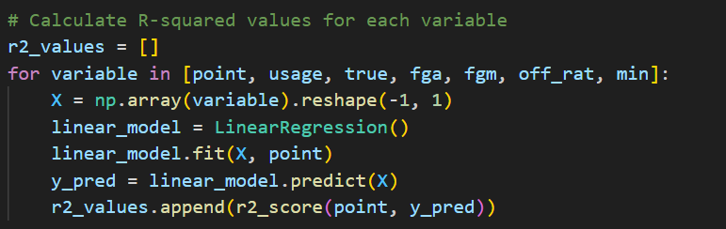

Methodology
After grabbing these training values, we calculate R2 values for each statistic and normalize these values to define a custom set of weights for our model

Slide 6
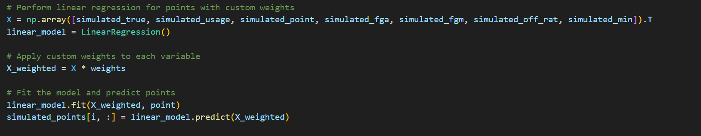
Methodology
We then run 10000 simulations using the customized weights to adjust the input into the linear regression model

Slide 7
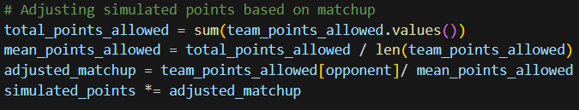
Methodology
Finally, we adjust the simulated points by taking into account the matchup and how many points the opposing team allows
We normalize the adjusted_matchup variable based on the mean of all team points allowed and the opponent points allowed

Slide 8
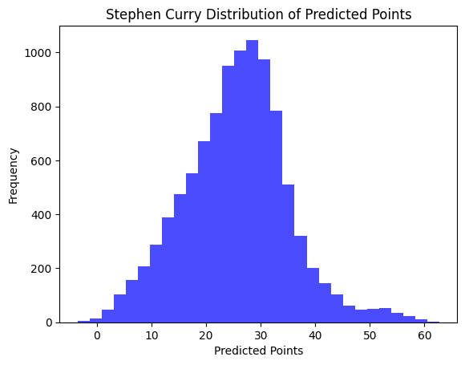
Ex: Steph Curry

Slide 9
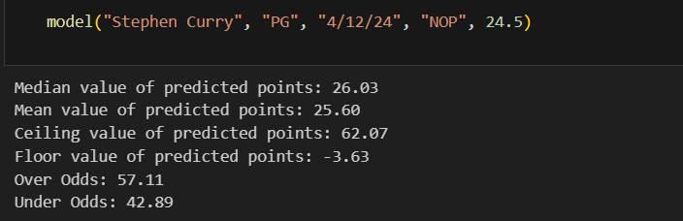
Individual Projections
Model prints out the Mean and Median of the players projection
Model displays the probability distribution of the projection
Model gives probability estimations for over and under

Slide 10
Testing for accuracy
To test our model, we pulled prop data from BetMGM. Each betting line has odds of -110 (Bet $110 dollars to profit $100, where the implied probability of this odds is 52.38%.) When the model is complete, we check the percentile of the betting line to the projected points and see if the model is predicting the over or under. Example:
Stephen Curry, Line 24.5 points
Model predicts Stephen Curry would score 26.08 based on the mean of all projections
Model recommends to pick the prop Over 24.5 points

Slide 11
Results
The model accurately predicted the over and under 65% accuracy when running 100 players for the 4/12/24 games
For projections that have greater than 5% difference of hitting the over than the implied odds, the model predicted the right bets 81% of the time.
For projections that have greater than 5% difference with the prop, the model predicted the right bets 78% of the time.

Slide 12
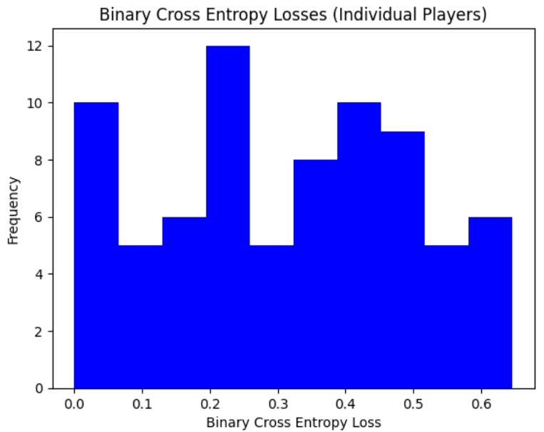
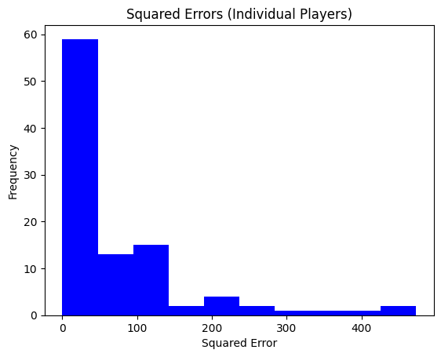
Results

Slide 13
Future Extensions
Model type:
We currently use a multivariate linear regression model to learn weights for each stat and then use these weights to simulated projected points
Could try other linear models (e.g. Bayesian Regression)
Could try nonlinear models such as a shallow neural network
Leveraging more player stats
E.g. a variable for whether a game is home or away
Varying how far back in a player’s history we scrape data from (perhaps introducing higher weighting for more recent games)
Factor multiple defensive stats such as pick and roll, pull up 3 pointers, pace
Expanding to other leagues
Our model is tailored around basketball so WNBA seems like a reasonable extension
Creating an app to house the model

